Slide 1
Digital Image Processing
DIGITIZATION_I

Slide 2
Summery of previous Topic
Digital image processing techniques
Application areas of the digital image processing
History of image processing techniques
Steps in digitization of images

Slide 3
Image Digitization
Why do we need to digitization?
What is digitization?
How to digitize an image?

Slide 4
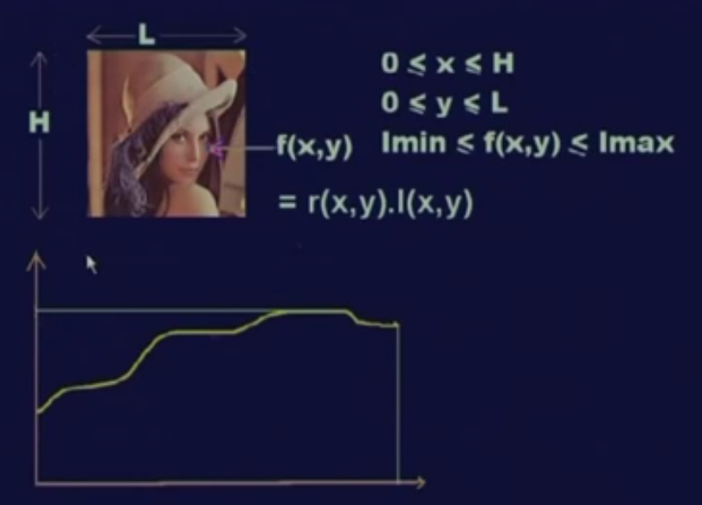
Why digitization we need?

Slide 5
Why digitization we need?
Theory of real numbers: between any two given points there are infinite numbers of points.
An image is represented by infinite number of points
Each such image point may contain one of the infinitely many possible intensity/color values needing infinite number of bits
Its not possible to represent infinite number in computer

Slide 6
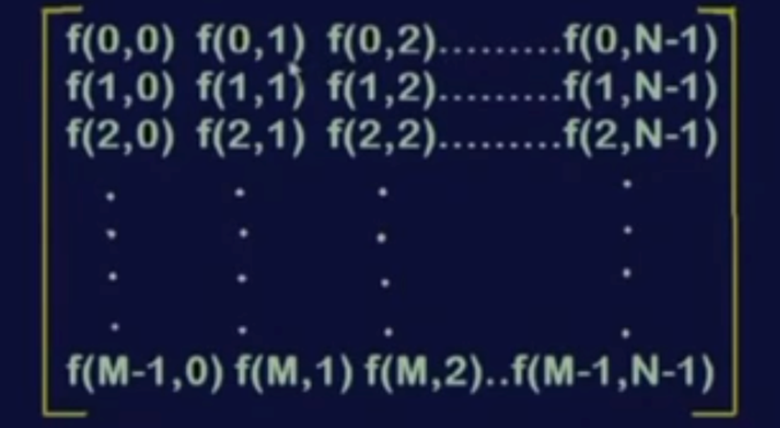
Digitization
: An image shall be represented in a form of a finite 2D matrix
2: The element values of f should also be finite

Slide 7
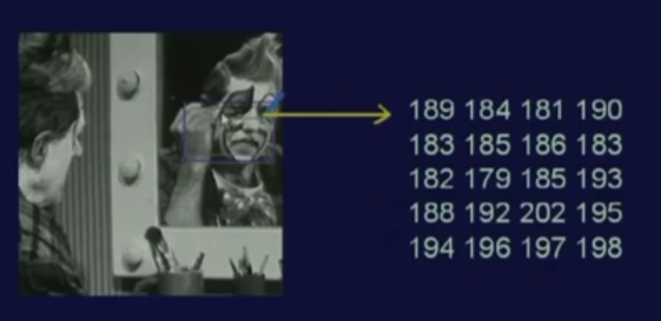
Image as a matrix of numbers representation

Slide 8
What is digitization ?
Sampling:
Image representation by 2-D finite matrix
Quantization:
Values of the Elements at the matrix are from the finite set of discrete values

Slide 9
To process images we need
To digitize the image
Sampling
Quantization
To visualize the image it needs to for displaying the images, it has to be first converted into the analog signal which is then displayed on a normal display.

Slide 10
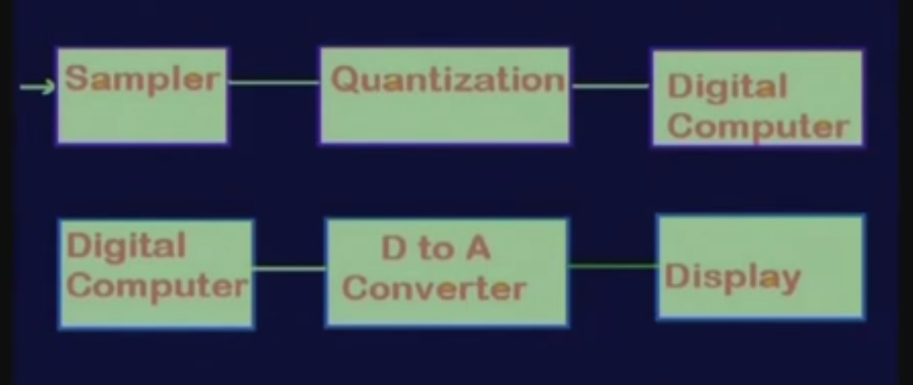
Sampling , Quantization and Display

Slide 11
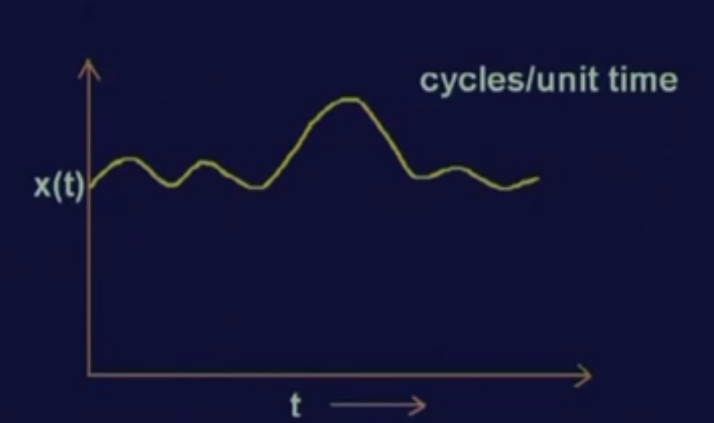
Sampling

Slide 12
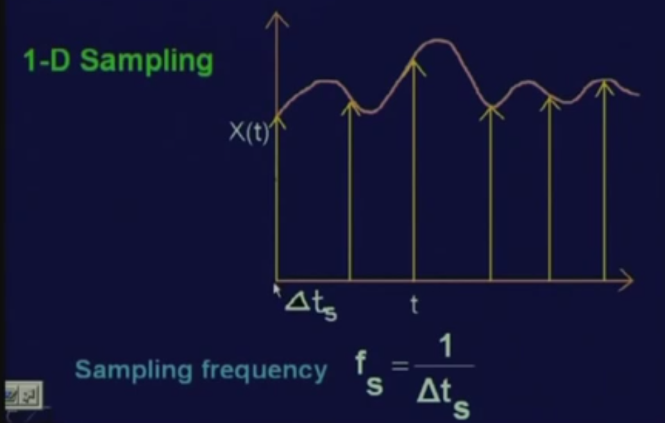
Sampling
Issue is local minimum, local maximum

Slide 13
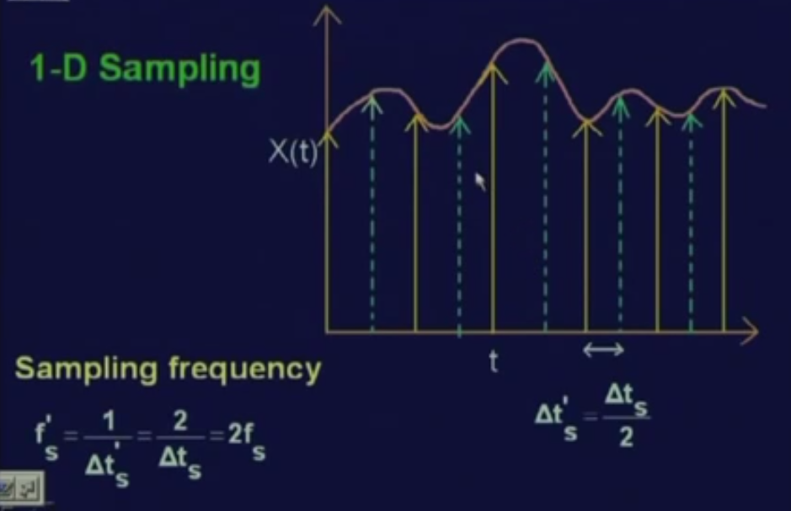
Sampling issue

Slide 14
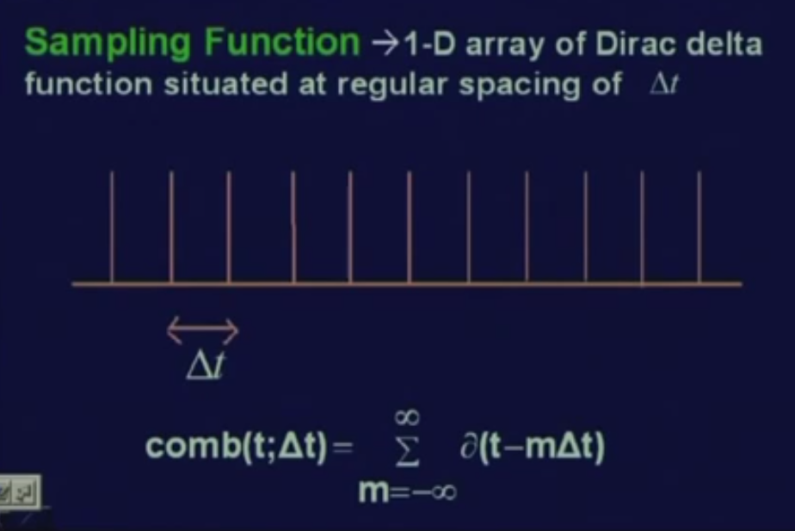

Slide 15
Each of these are sequences of Dirac delta functions and the spacing between 2 delta functions is delta t.
In short, these kind of function is represented by comb function, a comb function t at an interval of delta t and delta t minus m into delta t, where m varies from minus infinity to infinity.

Slide 16
Dirac delta function
Dirac delta function delta t, the functional value will be 1 whenever t equal to 0
the functional value will be 0 for all other values of t.
In this case, when delta t minus m of delta t, this functional value will be 1 only when this quantity that is (t minus m delta t) becomes equal to 0.
That means this functional value will assume a value 1 whenever t is equal to m times delta t for different values of m varying from minus infinity to infinity.

Slide 17
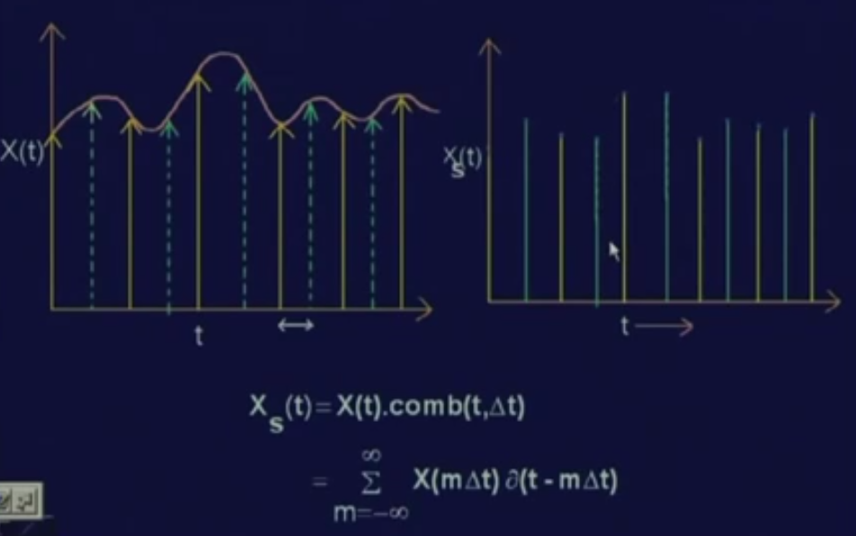
Theory of sampling
Notes:
These samples can now be represented by multiplication of X (t) with the series of Dirac delta functions that we have seen that is comb of t delta t.
So by multiply, whenever this comb function gives a value 1; only the corresponding value of t will be retained in the product and
whenever this comb function gives you a value 0, the corresponding points, the corresponding values of X (t) will be said to 0.

Slide 18
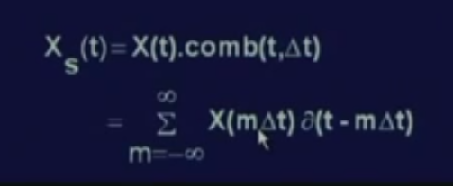
Theory of sampling

Slide 19
Theory of sampling
The discretization process can be represented mathematically as x S (t) is equal to X (t) into comb of t delta t and
If expand the comb function and consider only the values of t where this comb function has a value 1, then this mathematical expression is translated to x of m delta t into delta t minus m delta t where m varies from minus infinity to infinity.

Slide 20
Sampling from signal
The sampling will be proper if its to be reconstruct the original continuous signal X (t) from these sampled values
For that needs to maintain certain conditions so that the reconstruction of the analog signal X (t) is possible.

Slide 21
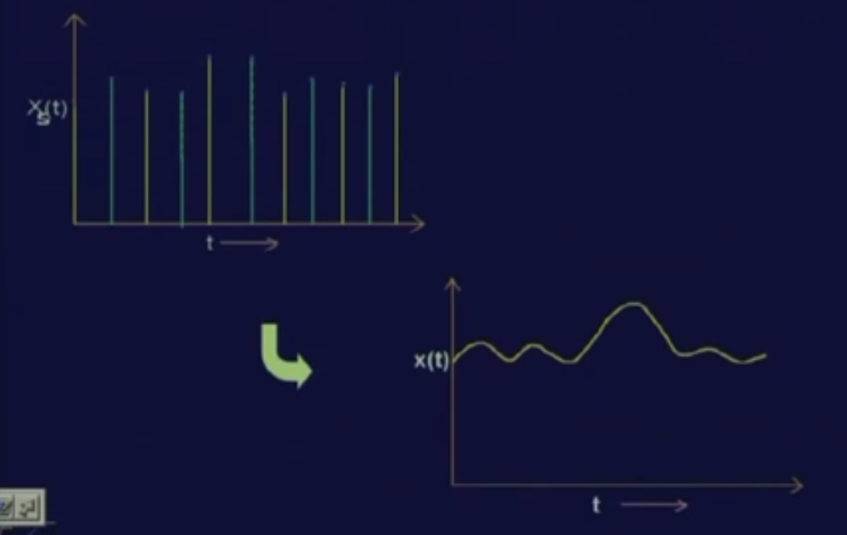
Sampling from signal

Slide 22
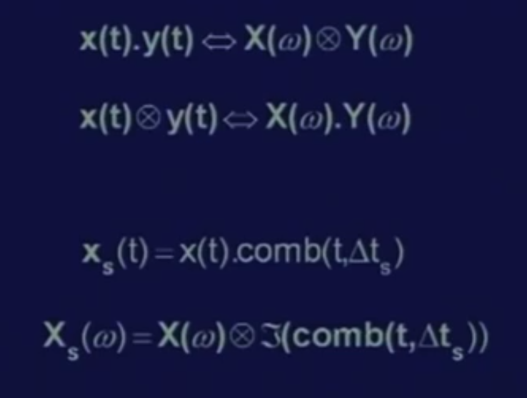
Reconstruction

Slide 23
Reconstruction
In time domain One signal is X (t), the other signal is comb function, comb of t delta t. So, these relations, as these are true that if multiply 2 signals X (t) and y (t) in time domain that is equivalents to convolution of the 2 signals x omega and y omega in the frequency domain.
For Sampling we have got x s (t) that is the sampled values of the signal X (t) which is nothing but multiplication of X (t) with the series of Dirac delta functions represented by comb of t delta t.

Slide 24
Reconstruction
It is equivalent to in frequency domain, x S of omega which is equivalent to the frequency domain representation x omega of the signal X (t) convoluted with the frequency domain representation of the comb function, comb t delta t and
The comb function is the Fourier transform or the Fourier series expansion of this comb function which is again a comb function.

Slide 25
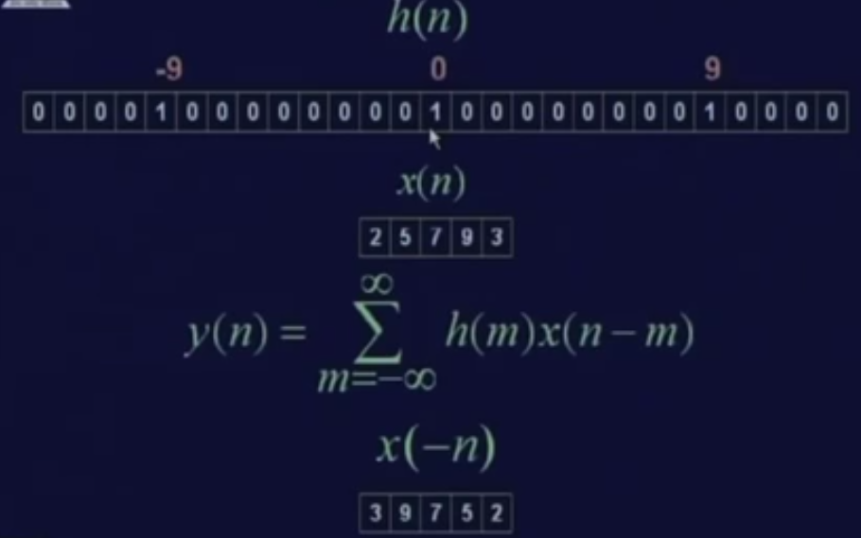
Convolution

Slide 26
2 signals h (n) and x (n) are in the sample domain.
h (n) is nothing but a comb function where the delta t S have value of h (n) is equal to 1 at n equal to 0, …
In discrete data domain, the convolution expression is translated to y (n) equal..
So, let us see that how this convolution actually takes place.

Slide 27
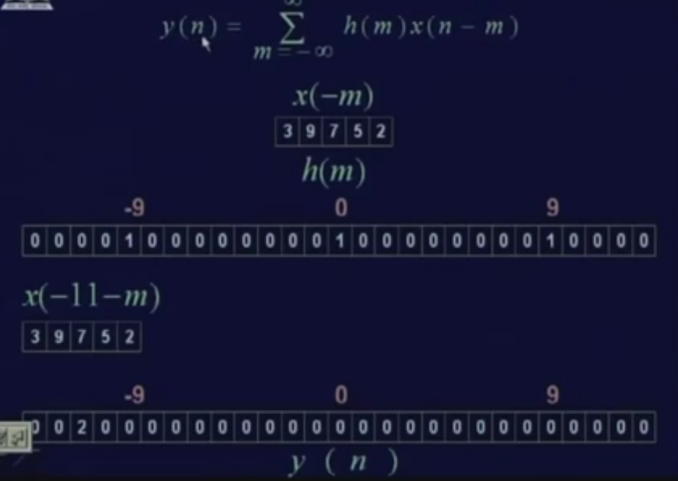

Slide 28
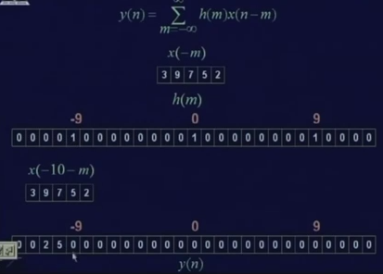

Slide 29
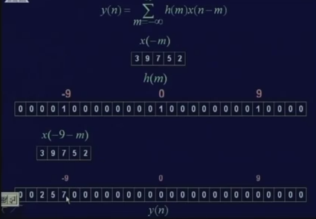

Slide 30
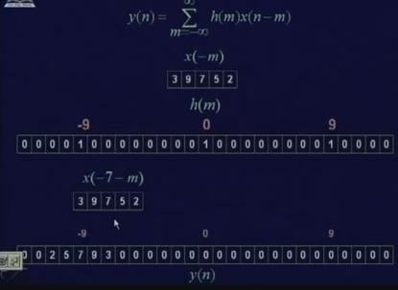

Slide 31
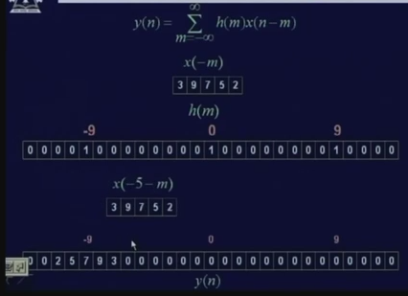

Slide 32
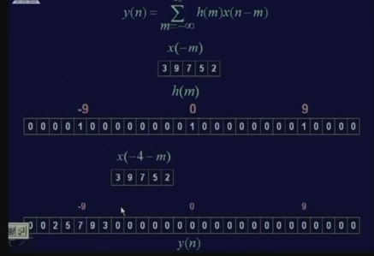

Slide 33
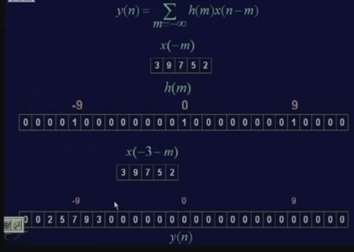

Slide 34
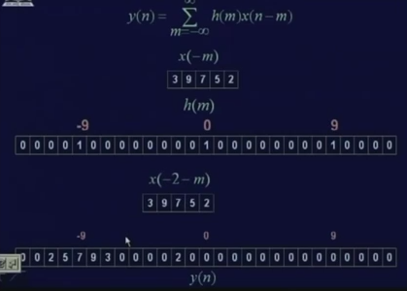

Slide 35
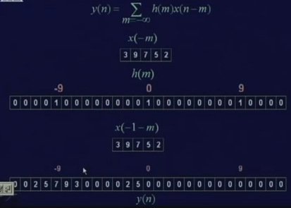

Slide 36
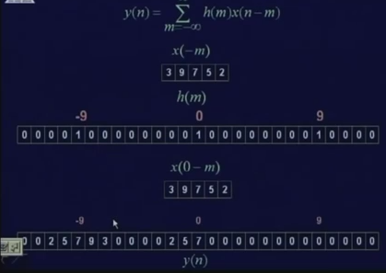

Slide 37
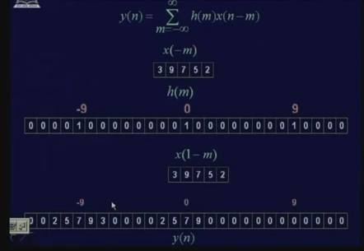

Slide 38
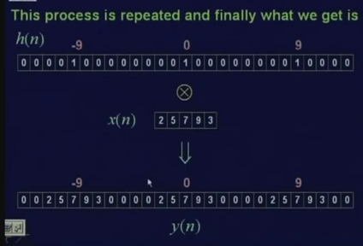

Slide 39
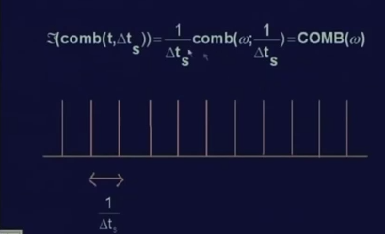
Convolute 2 signals X (t) and the Fourier transform of this comb function that is comb omega in the frequency domain

Slide 40
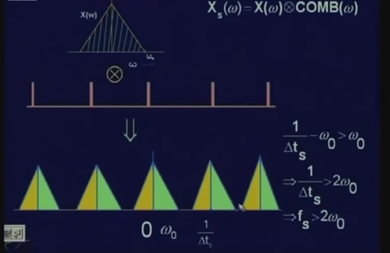

Slide 41
When X (t) is band limited, that means the maximum frequency component in the signal X (t) is omega naught; then the frequency spectrum of the signal X (t) which is represented by x omega
With low pass filter whose cut off frequency is just beyond omega naught and this frequency signal, will pass through low pass filter and will just take out this particular frequency band and it will cut out all other frequency bands.

Slide 42
The frequency gap between this frequency band and this translated frequency band are
The difference of between center of frequency band and the other center of frequency band is nothing but 1 upon t S which is equal to omega s that is the sampling frequency.

Slide 43
As long as this condition that is 1 upon t S minus omega naught is greater than omega naught, that is the lowest frequency of this translated frequency band is greater than the highest frequency of the original frequency band;
then only these 2 frequency bands are disjoint and when these 2 frequency bands are disjoint, then only by use of a low pass filter, I can take out this original frequency band.

Slide 44
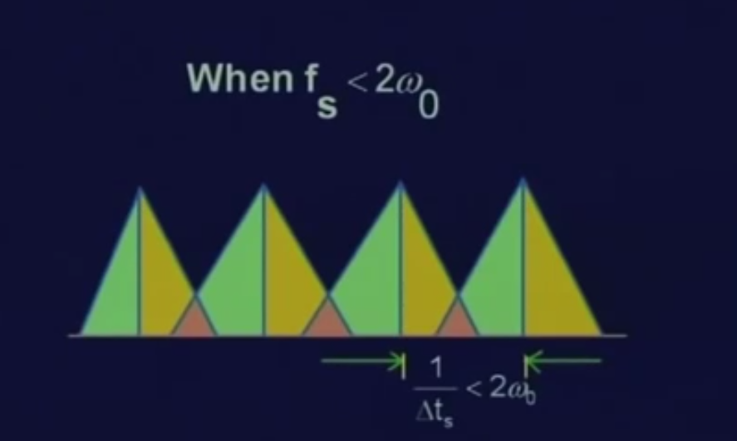
Aliasing
What happens if the sampling frequency is less than twice of omega naught?
In that case you find that subsequent frequency bands after sampling overlap and because of this overlapping, a single frequency band cannot be extracted using any of the low pass filters.

Slide 45
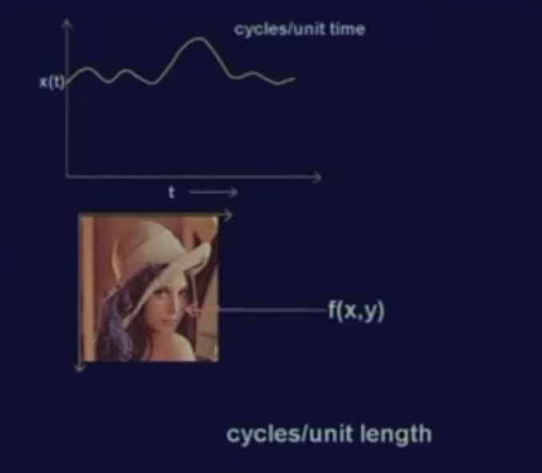
2D Image Sampling
If t is time, in that case X (t) is a signal which varies with time and for such a signal, the frequency is measured as you know in terms of hertz which is nothing but cycles per unit time.
How do you measure the frequency in case of an image?
In case of an image, the dimension is represented by 5 centimeter by 5 centimeter or 10 centimeter by 10 centimeter etc.
The image, can be measure in the frequency; cycles per unit length

Slide 46
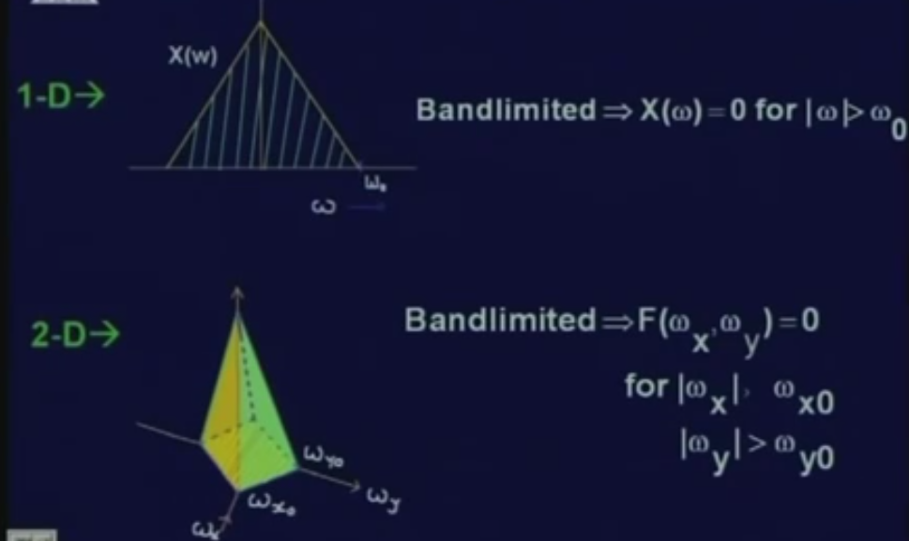
2D Image Sampling

Slide 47
2D Image Sampling
Signal X (t), is the frequency spectrum represented by X of omega and the signal X (t) is band limited if X of omega is equal to 0 for omega is greater than omega naught where omega naught is the bandwidth of the signal X (t).
in case of an image, the frequency of 2 components
one in the x direction
other in the y direction. Which is, omega x and omega y.
band limited if f of omega x omega y is equal to 0 for omega x greater than omega x0 and omega y greater than omega y0.
In this case, the maximum frequency component in the x direction is omega x0 and the maximum frequency component in the y direction is omega y0.

Slide 48
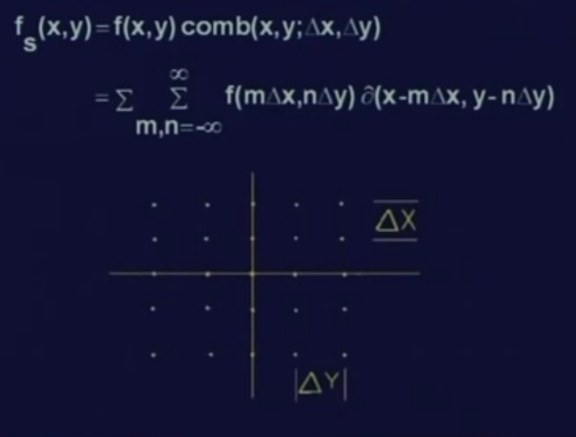
2D Image Sampling
2 variables x and y is nothing but a 2 dimensional array of the delta functions where along x direction, the spacing is delta x and along y direction, the spacing is delta y.

Slide 49
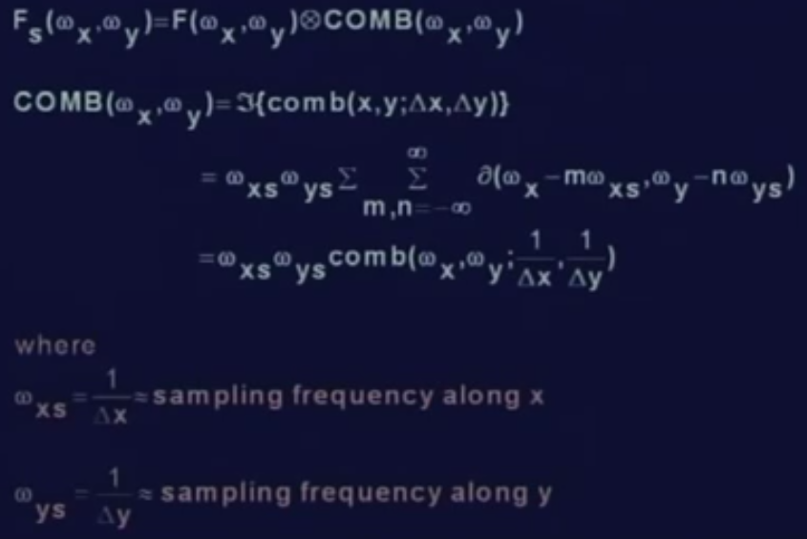
2D Image Sampling

Slide 50
2D Image Sampling
Same as 1 dimensional signal; to find the frequency spectrum of the sampled image,
Convoluted with comb
Comb is Fourier transform of omega xs omega ys
Where omega xs is 1 by delta x

Slide 51
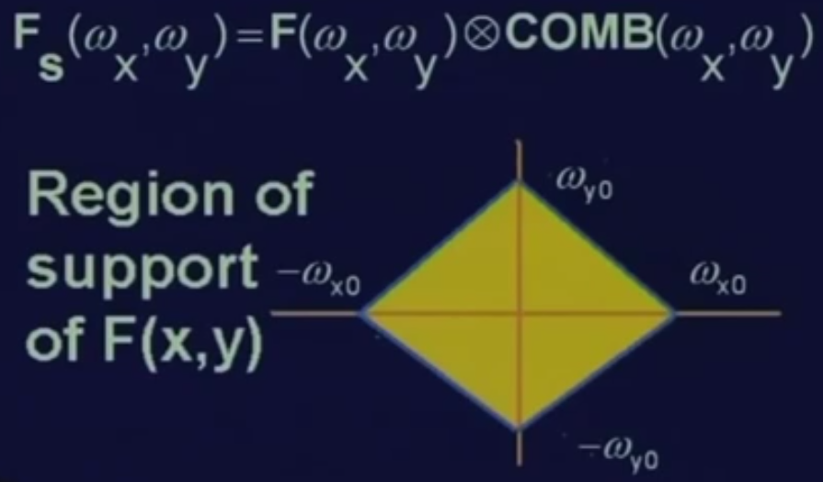
2D Image Sampling
FS (omega x omega y) which is the convolution of (F omega x omega y) “which is the frequency spectrum of the original image” convoluted with comb (omega x omega y) “which is the Fourier transform of the sampling function in 2 dimension”
The convolution operation replicates the original frequency spectrum in omega axis in case of 1 dimensional signal;
in case of 2 dimensional signal this will be replicated, along both x direction and y direction.

Slide 52
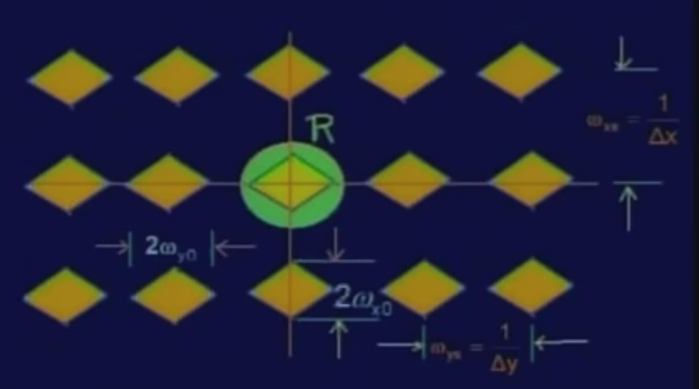
2D Image Sampling
We get 2 dimensional array of the spectrum of the image
So here again, we find out that the region of support getting replicated along y direction and along x direction
The spacing between 2 subsequent frequency band along the x direction is equal
to omega xs which is 1 upon delta x and
along y direction, the spacing is 1 upon delta y which is nothing but omega ys and that is the sampling frequency along the y direction.

Slide 53
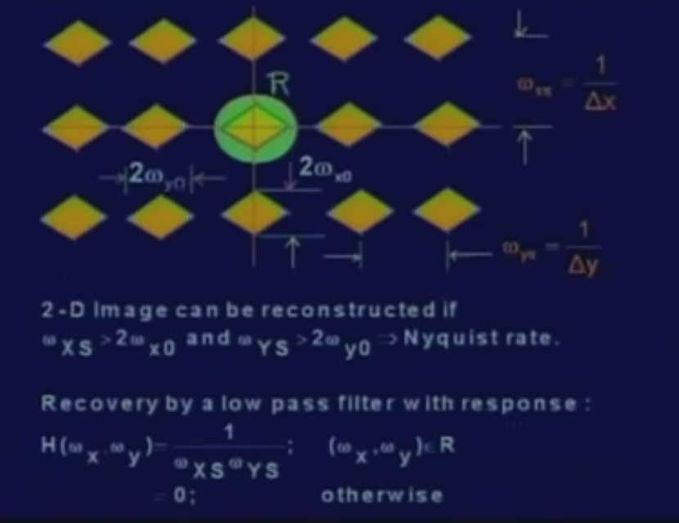
Reconstruction of the original image from spectrum
We need to take out a particular frequency band
For that that the signal has pass through a low pass filter whose response is given by H (omega x omega y) is equal to 1 upon omega xs into omega ys for omega x omega y in the region R where region R just covers this central band and it is equal to 0 outside this region R.
For the low pass filter the same condition of the Nyquist rate applies.
That is sampling frequency in the x direction must be greater than twice of omega x naught “which is the maximum frequency component along x”
And the sampling frequency along y direction has to be greater than twice of omega y naught “which is the maximum frequency component along direction y “

Slide 54
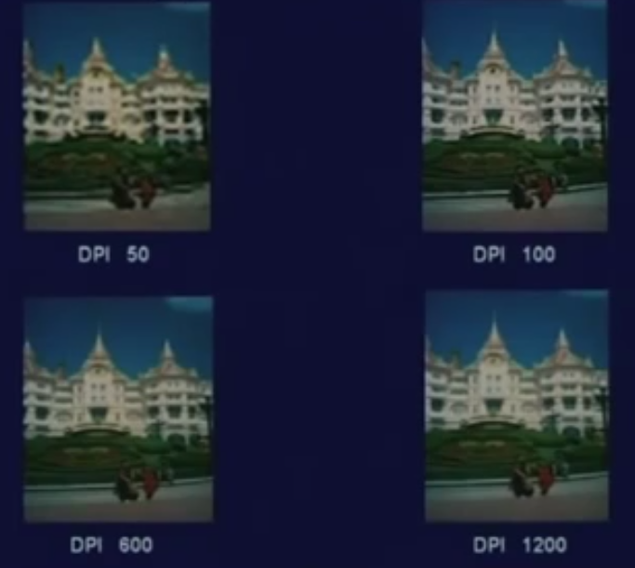
Results
Sampled with 50 dots per inch or 50 samples per inch and so on
When your sampling frequency is above the Nyquist rate, you are not going to get any improvement of the image quality.
Whereas, when it is less than the Nyquist rate, image is very bad.

Slide 55
Image Sampling and Quantization
Digitizing the coordinate values
Digitizing the amplitude values

Slide 56
Image Sampling and Quantization

Slide 57
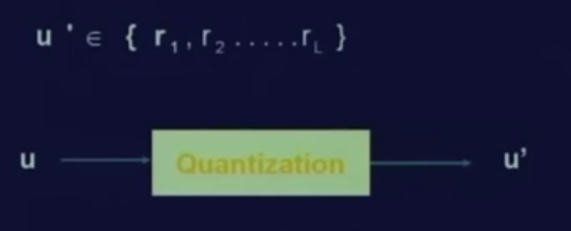
Quantization of the sampled values
Quantization is a mapping of the continuous variable u to a discrete variable u prime
Where u prime takes values from a set of discrete variable r1 to rL.

Slide 58
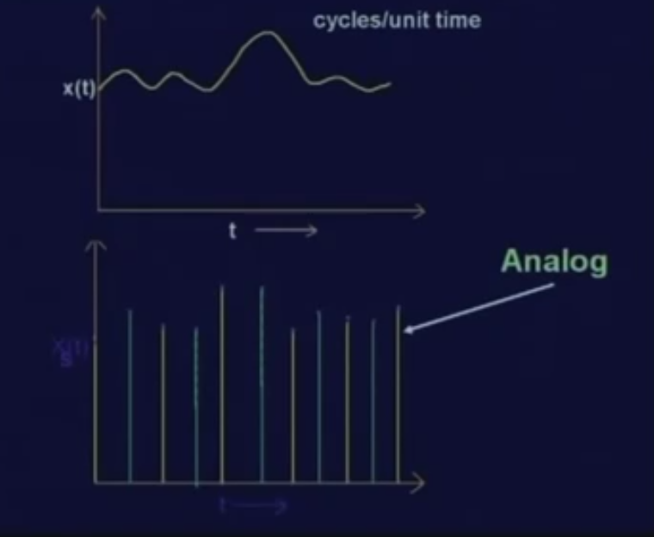
Quantization of the Sampled Values
By Sampling of a continuous signal, we get discrete samples in time domain. But still, every sample value is an analog value; it is not a discrete value.
Which means the signal values at all possible time instants; we have considered only the discrete time instants and at each of this discrete time instants, the value of this sample is still an analog value.

Slide 59
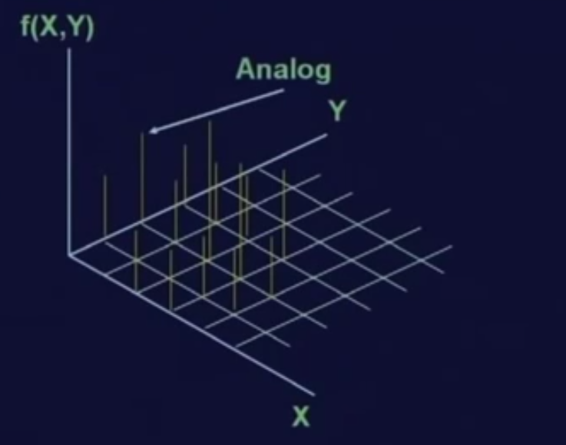
In Image
In case of an image, the sampling is done in 2 dimensional grids where at each of the grid locations, a sample value is analog.
If I want to represent a sample value in a digital computer, then this analog sample value cannot be represented.
So, we need quantization for this purpose.

Slide 60
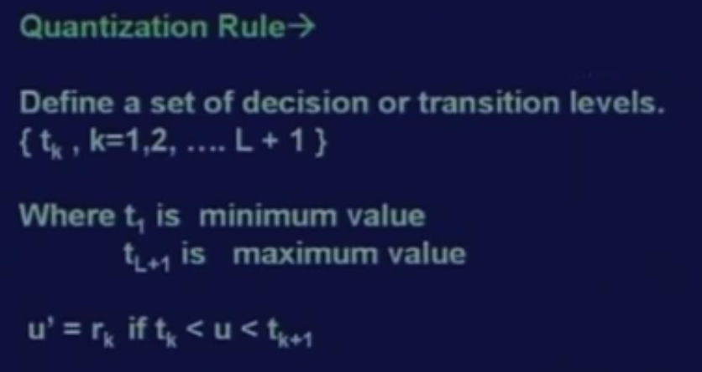
Staircase function
The quantization is a mapping which is generally a staircase function.
We define a set of decision or transition levels which is transition level tk where k varies from 1 to L plus 1.
And also defined a set of the reconstruction levels that is rk.

Slide 61
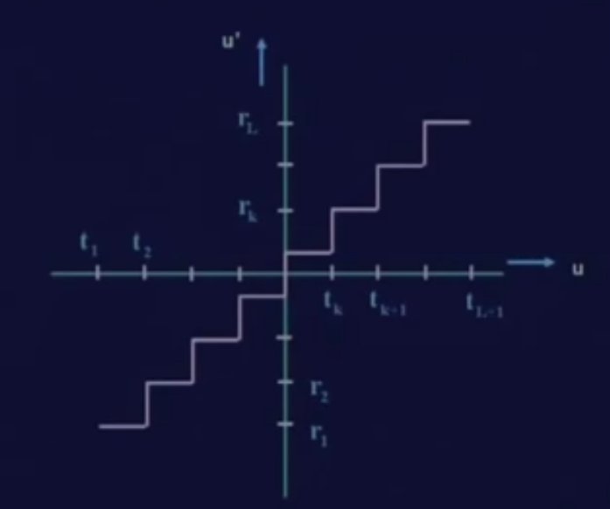
Input output relationship of a Quantizer
By input signal u, along the horizontal direction and along the vertical direction the output signal u prime which is the quantized signal.
If input signal u lies between the transition levels t1 and t2; then the reconstructed signal or the quantized signal will take a value r1.
If the input signal lies between t2 and t3, the reconstructed signal or the quantized signal will take a value r2.
Similarly, if the input signal lies between tk and tk plus 1, then the reconstructed signal will take the value of rk and so on.
The input signal is analog in nature and ^{the output signal is discrete.}
So, the output signal can take only one of these discrete values, the output signal cannot take any arbitrary value.

Slide 62
Image Sampling and Quantization

